Slide 1
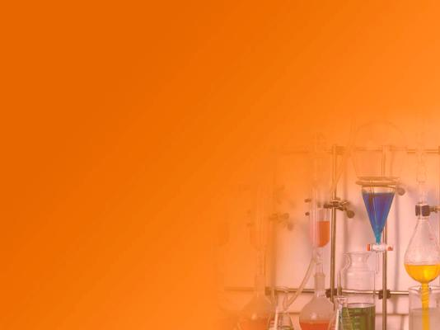
Chemistry
A Pathfinder Honor

Slide 2
Energy and Chemistry of Life Video

Slide 3
What is Chemistry
What do you think? Make a cluster to show what you know already about Chemistry.
Chemistry is the science of
matter and the changes
it undergoes.

Slide 4
Discovery Cards
On 3x5 cards, put the term and definition on the front and put a picture and/or example on the back.
You will be given several definitions and several pictures. Try to match each definition and each picture with the correct term on your card.

Slide 5
Prepare your Cards
Put each of these terms on a 3x5 card
Elements
Compounds
Chemical symbols
Solutions
Atoms
Molecules
Periodic Table
Combustion
Acid
Salt
Proton
Neutron
Electron
Distillation
Fractional Distillation
Filtration

Slide 6
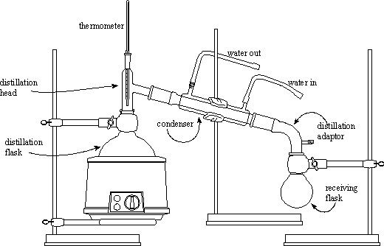
What Is It
Answer: Distillation
A technique of separating chemical substances (usually liquids) based on the temperature at which they evaporate.

Slide 7
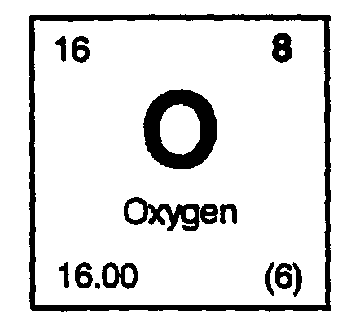
What Is It
A class of substances that cannot be separated into simpler substances by chemical means.
Answer: Element

Slide 8
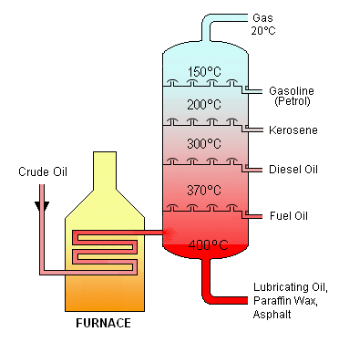
What Is It
A technique in which several distillations occur in the same column, mediated by some sort of porous medium. It allows the separation of substances with closer boiling points than simple distillation, and also makes the distillation of the same solutions more efficient.
Answer: Fractional Distillation

Slide 9
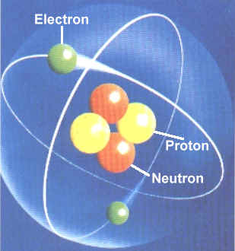
What Is It
A positively charged particle that is a part of the nucleus of an atom.
Answer: Proton

Slide 10
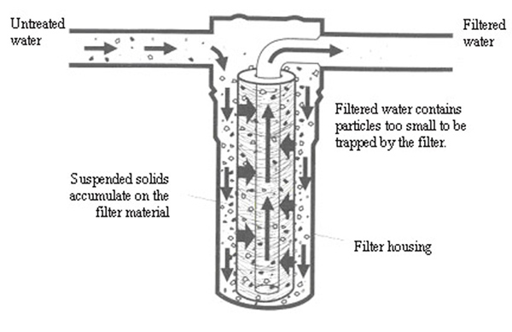
What Is It
A technique in which a solid precipitate (or solid waste) is separated from a liquid.
Answer: Filtration

Slide 11
What Is It
A neutrally charged particle that is a part of the nucleus of an atom. Can be quite stable because of another force known as the "Strong Force"
Answer: Neutron

Slide 12
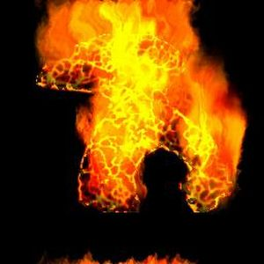
What Is It
We often use this word to describe the chemical process of a fuel combining rapidly with a oxidizer (usually oxygen)i.e. burning. This process usually is associated with flames, light, heat, and smoke.
Answer: Combustion

Slide 13
What Is It
Negatively charged particles that form a cloud about the positively charged nucleus of an atom.
Answer: Electron

Slide 14
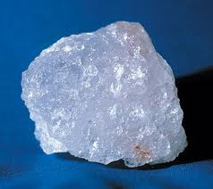
What Is It
A term for the solid form of an ionic compound, such as Sodium Chloride (Na⁺Cl⁻) or potassium hydroxide (K⁺(OH)⁻).
Answer: Salt

Slide 15
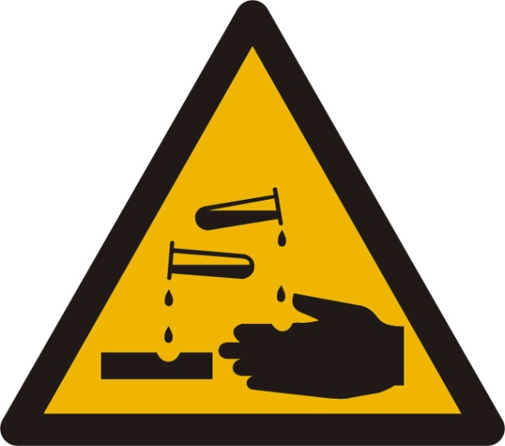
What Is It
This word is from the Latin word acidus which means sour. In the early days of chemistry, it was a common practice to taste or smell things and record the sensation.
Answer: Acid

Slide 16
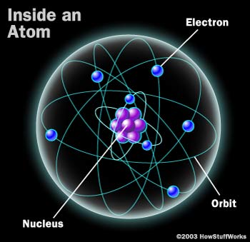
What Is It
The basic building blocks of matter. These are mostly empty space, but because the electrons are moving so rapidly, the matter we touch can feel very solid.
Answer: Atom

Slide 17
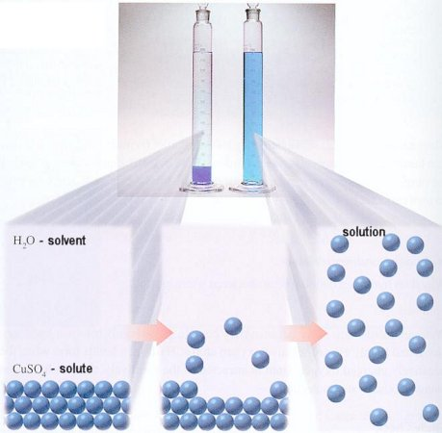
What Is It
A mixture of two or more substances that do not react chemically. If you dissolve sugar, salt, or another substance in water, you are creating a solution.
Answer: Solution

Slide 18
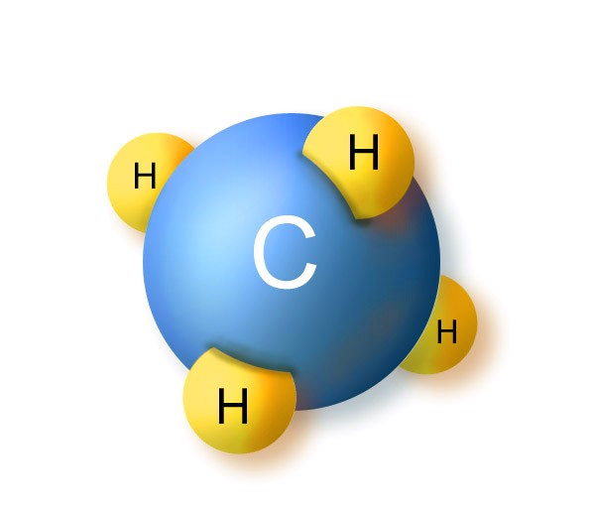
What Is It
Two or more atoms that have bonded to each other.
Answer: Molecule

Slide 19
What Is It
A tabular method of displaying the chemical elements. It illustrates recurring trends in the properties of the elements.
Answer: Periodic Table of Elements

Slide 20
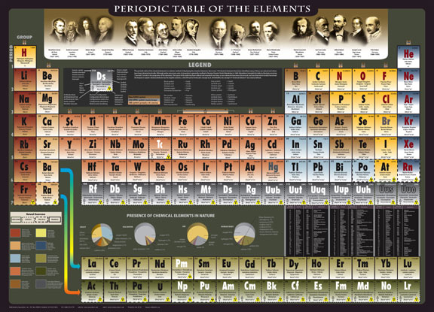

Slide 21
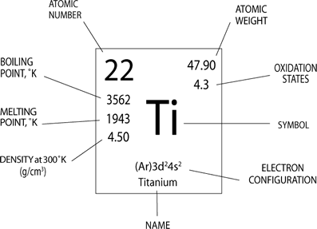
What Is It
Every element is represented using an abbreviation of one or two characters that represent the name of the element.
The first character is capitalized, and the second character is always lower case. There are 94 elements found naturally on earth, and 17 that have been created.
Answer: Chemical Symbol

Slide 22
What Gases Extinguish life
In the extreme, almost any gas can kill a person. Even pure oxygen can kill because the body cannot deal effectively with pure oxygen.
The gases can kill by:
Suffocation- The gas displaces oxygen and the body now starved of oxygen dies.
Poison- There are gases such as Cyanide gas which are highly poisonous.
Explosion- Many gases are quite flammable and can explode quite destructively.
Fire requires oxygen, so a method used in fire extinguishers is to use a gas or liquid that will keep the oxygen from getting to the fuel.

Slide 23
Carbon Monoxide
Carbon monoxide (CO), also called carbonous oxide, is a colorless, odorless and tasteless gas which is slightly lighter than air. It is highly toxic to humans and animals in higher quantities
It comes from:
Automobile Exhaust
natural gas or propane stoves, heaters, hot water heaters, or clothes dryers
Exhaling

Slide 24
Properties of Matter Video

Slide 25
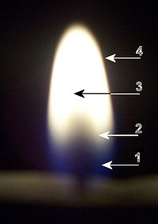
1) Blue zone
The blue area is the base of the flame. Part of combustion takes place here. Temperature 1200-1400ºC.
2) Dark zone
The dark area in the middle of the flame just above the tip. Hydrogen is being separated from the fuel and burned to form water vapor. Temperature 800-1000ºC.
3) Luminous zone
The yellow luminous area is above the dark area. This brighter, yellower part of the flame is the remaining carbon being oxidized to form carbon dioxide. The incandescent soot particles causes the orange and yellow glow. Temperature 1200ºC.
4) Flame Mantle
This is on the outer rim of the flame, and is colorless, or a very faint blue, and is the hottest part of the candle flame. Temperature1400ºC.

Slide 26
Chemistry and Forensics Video

Slide 27
Experiments and activities
Do the following to investigate chemistry in our world

